Slide 1
Calibrating Uncertainty for Semi-Supervised Crowd Counting
Chen Li, Xiaoling Hu, Shahira Abousamra, Chao Chen
Stony Brook University

Slide 2
Introduction
What is semi-supervised crowd counting?
Labeled images
Learning framework
Crowd counting
Unlabeled images
Wasted…
Fully-supervised crowd counting
Labeled images
Learning framework
Crowd counting
Unlabeled images
Semi-supervised crowd counting
Notes:
In fully-supervised crowd counting, only labeled images are utilized to train the model. Semi-supervised crowd counting use both labeled and unlabeled images to boost the model performance.

Slide 3
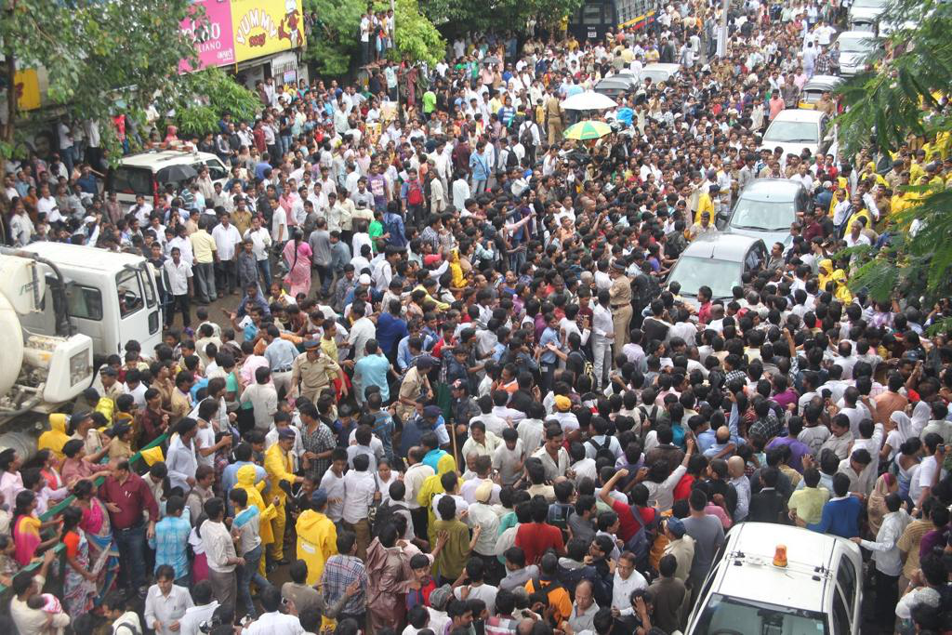
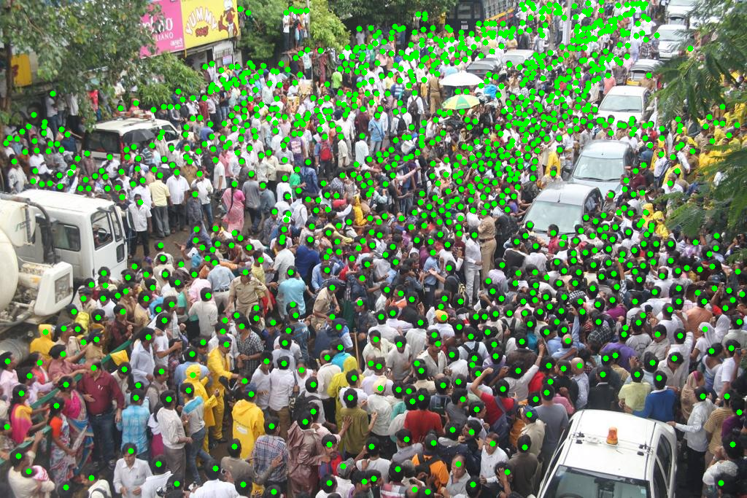
Introduction
Why semi-supervised crowd counting necessary?
Annotating
It is costly and time-consuming to annotate the images for crowd counting task.
Notes:
Why semi-supervised crowd counting necessary? to achieve superior performance, fully supervised methods require a large amount of annotations. For each image, hundreds or thousands of points/markers are added to indicate pedestrians, as we can see. Acquiring such annotations is costly and time-consuming; it takes 2000 human hours to annotate UCF-QNRF [10] dataset, which contains 1.25 million points/markers.

Slide 4
Introduction
Pseudo-labeling based semi-supervised crowd counting
Labeled images
Supervised Learning
Unlabeled images
Model
Predictions
Pseudo-labels
Filtering out unreliable predictions (uncertainty guided)
Notes:
To alleviate the annotation burden, semi-supervised crowd counting is explored to leverage the information in unlabeled images with fewer annotated images. A promising direction for semi-supervised crowd counting is pseudo-labeling, i.e., generating pseudo-labels for unlabeled data based on model prediction, and adding them as additional training data. To select reliable predictions as pseudo-labels, one may use the uncertainty of the model. Predictions with low uncertainties are considered more reliable and can be used as pseudo-labels to train the model. Despite the wide application of uncertainty in computer vision, estimating uncertainty in crowd counting remains a challenge, due to the heterogeneity of the marker distributions and fundamental issues of a crowded scene including perspective, occlusion, and cluttering.

Slide 5
Main contributions
We propose a novel supervised approach to calibrate patch-wise uncertainty for crowd counting task
We propose a novel patch-wise matching-based similarity measure as a surrogate function for uncertainty.
Based on the uncertainty estimator we proposed, we introduce a pseudo-labeling based semi-supervised crowd counting method.
Notes:
To solve the problem above We propose a novel supervised approach to calibrate patch-wise uncertainty for crowd counting task, We propose a novel patch-wise matching-based similarity measure as a surrogate function for uncertainty. Based on the uncertainty estimator we proposed, we introduce a pseudo-labeling based semi-supervised crowd counting method.

Slide 6
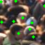
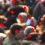
Intuition
Similarity
Ground truth
Model prediction
High
Low
Low uncertainty
High uncertainty
Notes:
The intuition behind our uncertainty estimation is that when a model can predict well, it should be less uncertain about the data. Thus we use the similarity between model prediction and ground truth as a surrogate for the uncertainty of a image patch. Higher similarity means lower uncertainty.

Slide 7
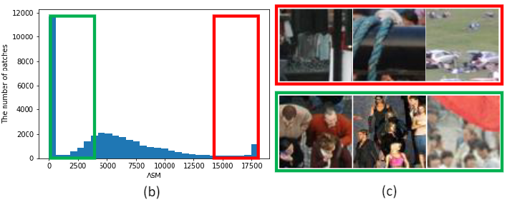
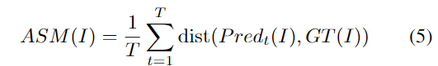
Spatial matching distance
unpaired
(a)
Notes:
To be more specific, we propose match-distance-based metric to compare the predicted and ground truth pedestrian point sets. Intuitively, we find an optimal matching between the two point sets, and the matching distance is used as the similarity measure. For each unmatched point, we add a constant penalty. The penalty constant should be proportional to the image patch size, essentially the worst possible matching distance between any two points. Due to the stochastic nature of deep learning optimizer, the prediction on a single epoch may not be reliable. We stabilize the proposed spatial matching distance by accumulating over snapshot models at different training epochs. Formally, our accumulated spatial matching distance (ASM) for a training patch, I, is as follows. fig(b) is the distribution of ASM on ShangHaitech A. Image patches in red are high uncertainty samples. Image patches in green are low uncertainty samples. The individuals in the red loop are difficult to locate while the crowds in the green loop are easy to count.

Slide 8
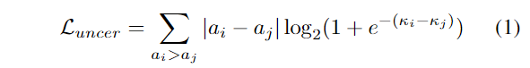
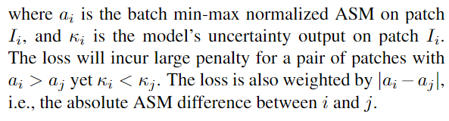
Uncertainty ranking loss
Notes:
To train the uncertainty branch, we propose a pairwise ranking loss. The loss ensures that the rank of uncertainty output is consistent with the rank of uncertainty surrogate. Compared with the numeric values of the surrogate function, the ranking is more stable and reliable. This is why ranking loss can achieve better performance than pointwise loss like L1 loss.

Slide 9
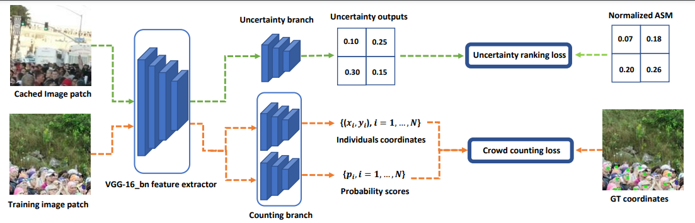
Uncertainty estimation
P2PNet (ICCV2021 Oral Presentation)
Notes:
Our model has two branches: one branch for crowd counting, one for uncertainty estimation. The crowd counting branch and loss are adopted from p2pnet.

Slide 10
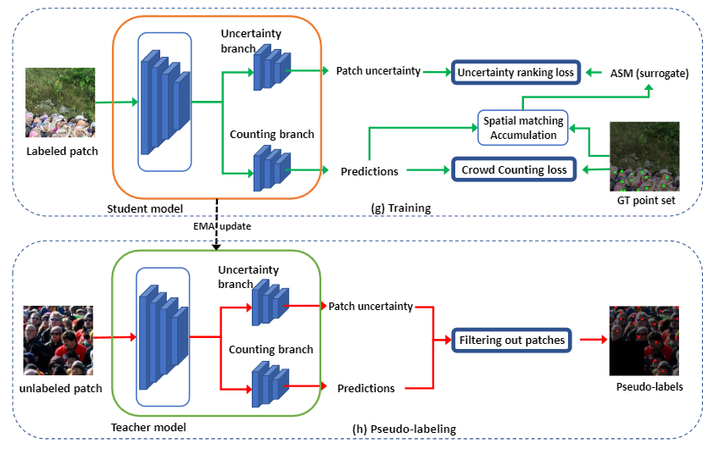
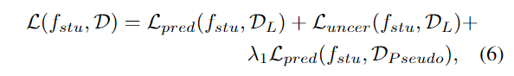
Semi-supervised crowd counting
Notes:
At every training epoch, we apply the teacher model to all unlabeled data, generating predictions and uncertainties. For each data (image patch), we compare its uncertainty with a preset uncertainty threshold, the low uncertainty patches are selected to supervise the training of crowd counting, the predictions are pseudo-labels.

Slide 11
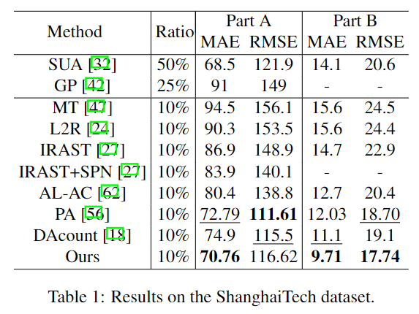
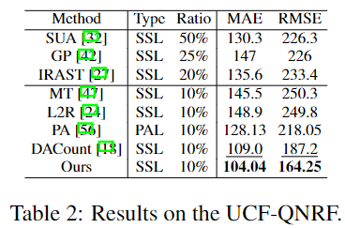
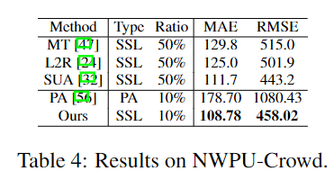
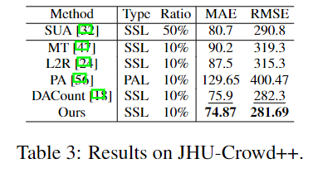
Experiment results
Notes:
To verify the effectiveness of our method, we conduct extensive experiments on five public datasets: ShanghaiTech Part-A and Part-B [64], UCF-QNRF [10], NWPU-Crowd [53], JHU-Crowd++ [45, 46]. The results show that our semi-supervised method consistently outperforms the state-of-the-art semi-supervised, partial-annotation, and active learning methods. This reflects that our uncertainty estimation is efficient for filtering out low-quality pseudo-labels. Hence, our semi-supervised framework can utilize the information in unlabeled images more effectively.

Slide 12
Conclusion
In this work, we introduce a novel patch-wise uncertainty estimation for pseudo-labeling-based semi-supervised crowd counting.
Our method train the uncertainty estimator directly through a surrogate function calculated on labeled patches.
Our method provides reliable uncertainty estimation, thus helps selecting pseudo-labels to improve the model training in a semi-supervised fashion.
The evaluation of our proposed semi-supervised method onseveral popular crowd counting benchmarks shows that our method consistently achieves superior performance compared to SOTA semi-supervised methods.

Slide 14
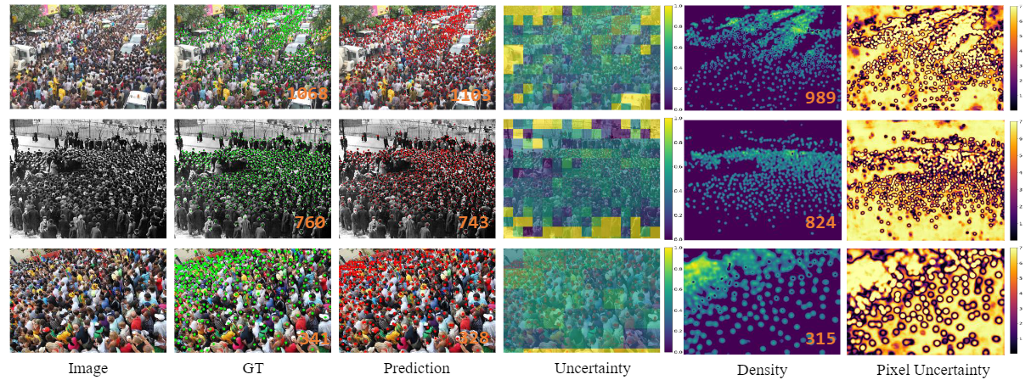
Quality results

Slide 15
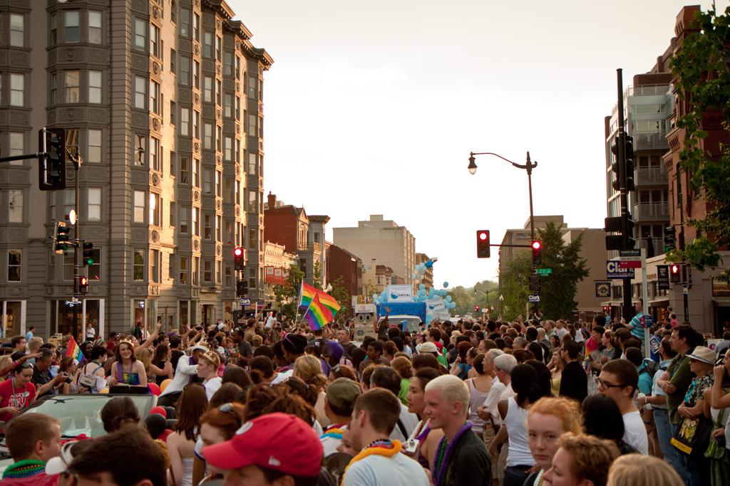
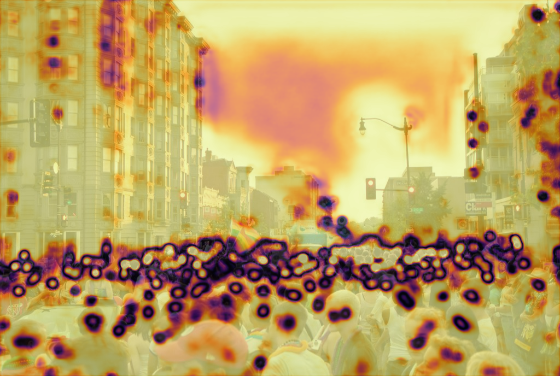
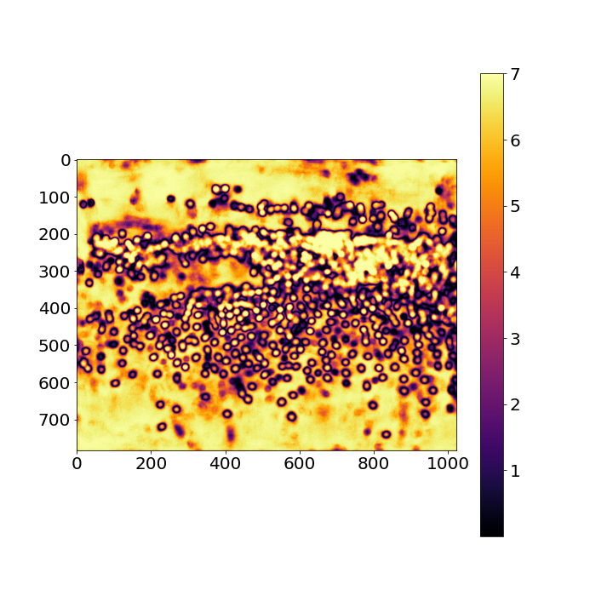

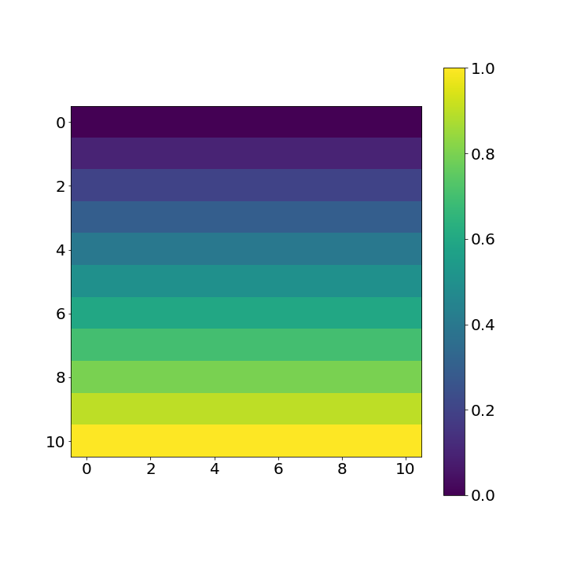
Why patch-wise uncertainty?
Uncertainty estimation for crowd counting task.
Uncertainty score:
0.5
Pixel-wise uncertainty
Patch-wise uncertainty
Image-wise uncertainty
Notes:
Why patch-wise uncertainty? For image-wise uncertainty, it is difficult to find a reliable score to summary all the uncertainty information across the whole image. Pixel-wise uncertainty is mostly based segmentation map which makes pixel-wise uncertainty fellows the pattern of segmentation. The high dense crowd region has the bias toward low uncertainty.

